Slide 1
Concurrency In Dart

Slide 2
synchronous and asynchronous programming
are two fundamental paradigms for managing task execution and
resource utilization in software development.

Slide 3
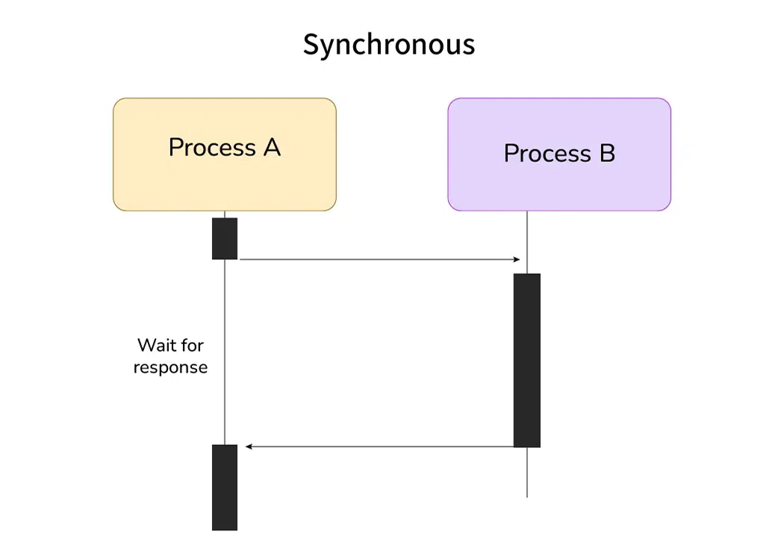
Synchronous (Blocking)
Tasks execute sequentially; each task must complete before the next begins.
Example: Reading a file, then processing its data, and finally displaying results -- each step blocks the next.

Slide 4
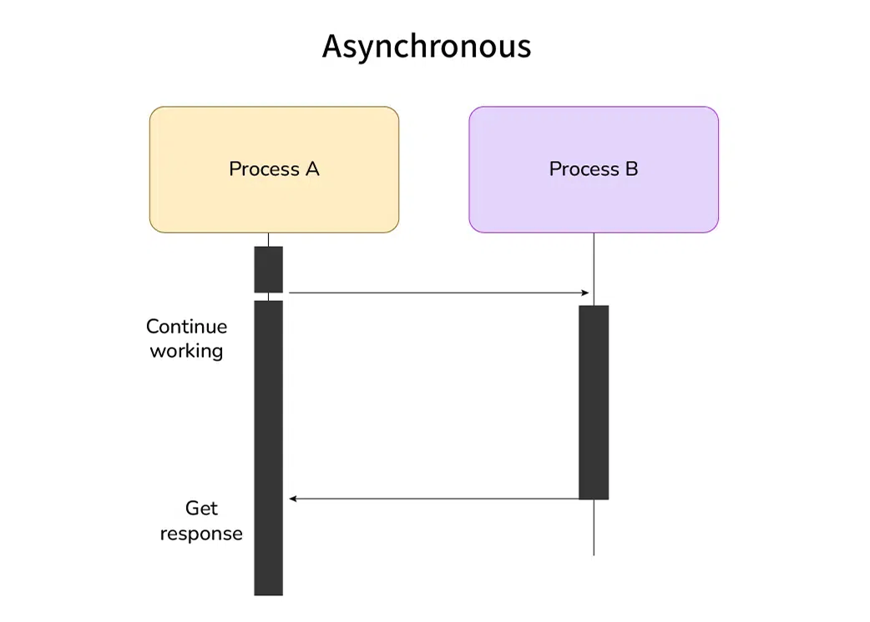
Asynchronous (Non-Blocking)
Tasks overlap; Tasks can run concurrently. Long-running operations start but don’t block subsequent code.
Example: Initiating a file read, processing other data while waiting, and handling the file data later via callbacks

Slide 5
Parallel Programming VS Multithreaded Programming

Slide 6
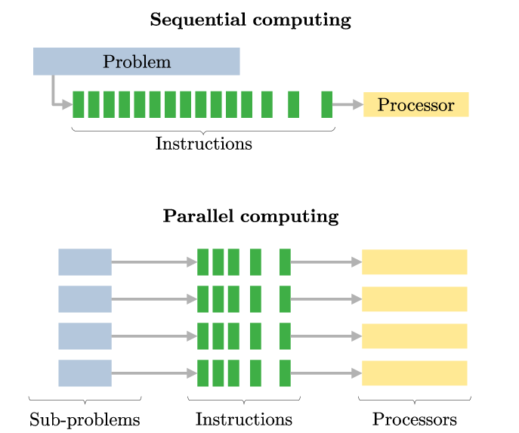
Parallel Programming
Focuses on simultaneous execution of tasks across multiple processors/cores or machines to solve a problem faster.(improve performance)
Goal: Solve problems faster by splitting work.

Slide 7
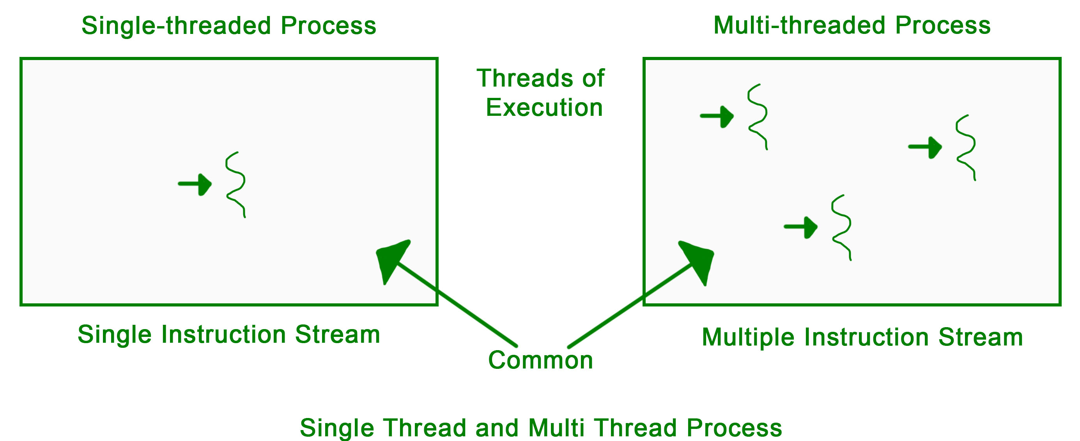
Multithreaded Programming
Aims for concurrency (managing multiple tasks, which may or may not run simultaneously). Threads can enable parallelism on multi-core systems or handle overlapping tasks
Goal: Improve responsiveness or utilize CPU cores.

Slide 8
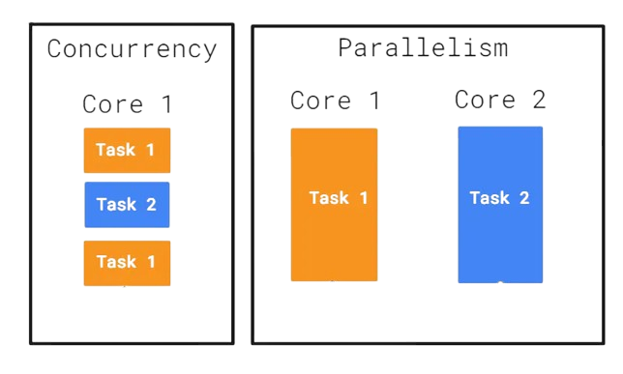
multiple processes working at the same time on a single CPU
(well actually not you think they do but they switch very fast between them).
multiple processes working
at the same time on multiple CPU's

Slide 9
Some major problems in multi-threading
A race condition : occurs when two or more threads access shared data simultaneously, and at least one thread modifies the data, causing unexpected results. Solution: thread locking.
Example:
class Counter {
int count = 0;
void increment() { count++; } // Not thread-safe!
}
// Thread 1: counter. Increment();
// Thread 2: counter. Increment();
// Final count could be 1 instead of 2.

Slide 10

Some major problems in multi-threading
Deadlocks: Two or more threads block forever, each waiting for a resource held by the other.
Example:
// Thread 1: Locks Resource A, then waits for Resource B.
// Thread 2: Locks Resource B, then waits for Resource A.

Slide 11

Dart
Dart is a single-threaded language that relies on an event loop to manage asynchronous operations, enabling non-blocking execution.
Dart runs code in a single main thread (isolate), executing instructions sequentially.
Prevents race conditions but requires careful handling of long-running tasks.

Slide 12
Event Loop
The Dart event loop is fundamental for managing the execution of both synchronous and asynchronous code in Dart applications. It ensures tasks are processed efficiently without blocking the main thread, enabling smooth and responsive apps, especially in Flutter.
In this guide, we'll explore how the Dart event loop works, focusing on its two key components—the event queue and the microtask queue. We'll also explain how different types of Futures interact with these queues, helping you write more predictable and efficient asynchronous code.

Slide 13
The Event Loop And Its Queues

Slide 14
1. Event Queue
Contains events triggered by external sources or scheduled tasks / deferred tasks
Examples:
Timers: Timer.run, Future.delayed.
I/O Operations: File reads, network requests.
UI Events: User interactions (e.g., button clicks in Flutter).
Future Computations: Future(() => ...).
Behavior: Tasks here are processed one at a time after all microtasks and synchronous code.

Slide 15
2. Microtask Queue
Holds internal, high-priority tasks that should run before events
Examples:
Callbacks of already completed Futures (created with Future.value or Future.sync)
Callbacks registered with .then() after a Future completes
Tasks scheduled with scheduleMicrotask() or Future.microtask()
Behavior: Emptied entirely before the event queue is touched.

Slide 16
How the Event Loop Processes Tasks
Execute Synchronous Code: Dart runs all synchronous code first.
Process Microtasks: If there are microtasks in the queue, Dart processes all of them.
Process One Event: Once the microtask queue is empty, Dart processes the next event from the event queue.
Repeat: After processing an event, Dart checks the microtask queue again.

Slide 17
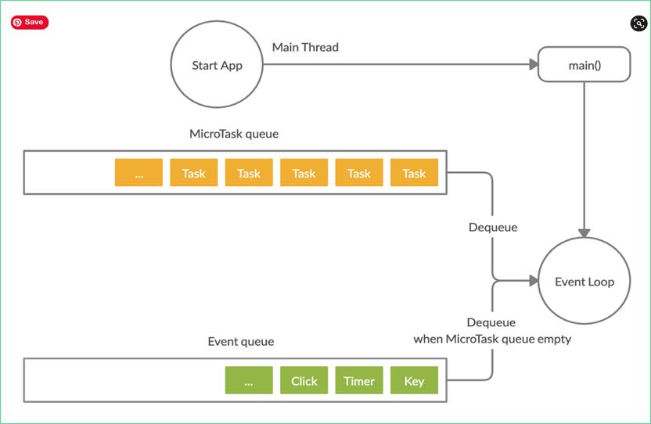

Slide 18



Slide 19
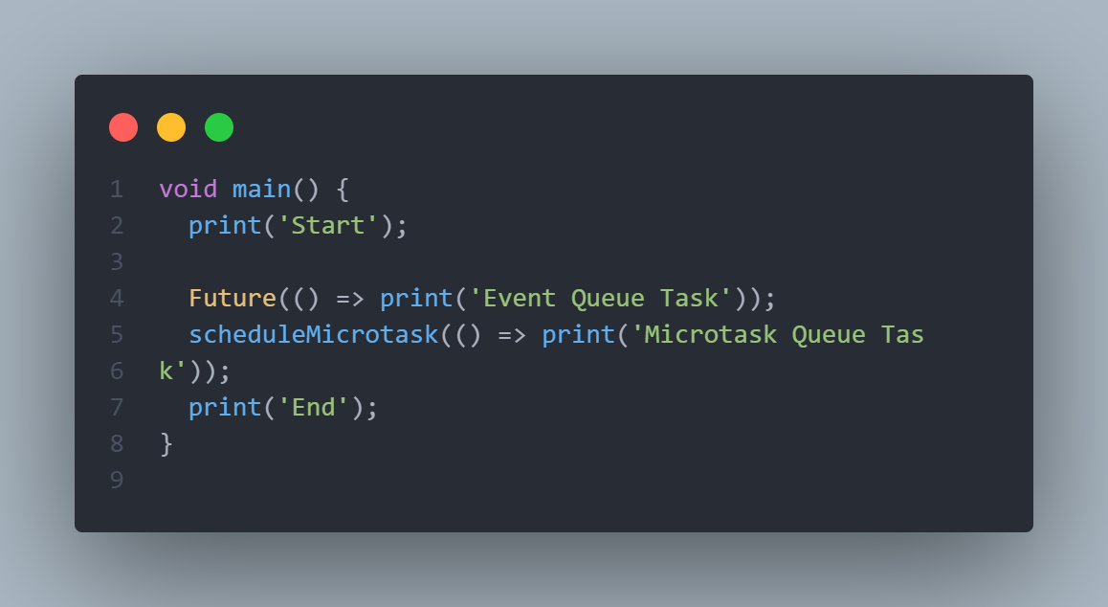
Example

Slide 20
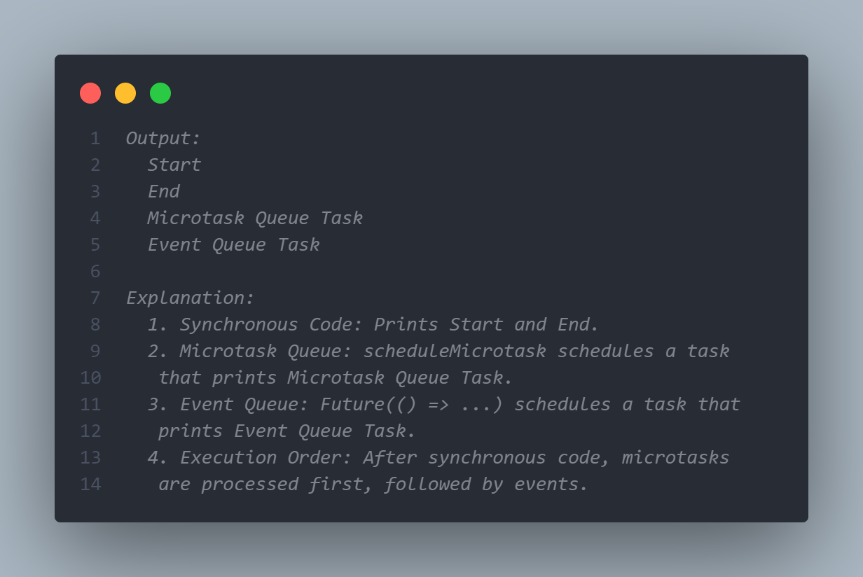
Output

Slide 21
Understanding Different Future Constructors

Slide 22
1. Future(() => ...) And Future.delayed(.., (() => ...)
Computation: Scheduled in the event queue.
Then Callbacks: After the computation completes, .then() callbacks are scheduled in the microtask queue.
Future(() => print('Event Queue Computation')).then((_) => print('Microtask Then'));
Future.delayed(Duration(milliseconds: 10), (() => print('Event Queue computation’)))
.then((_) => print('Future dot delayed Then'));
Execution Order:
Schedules print('Event Queue Computation') in the event queue.
After execution, schedules print('Microtask Then') in the microtask queue.

Slide 23
2. Future.microtask(() => ...)
Computation and Callbacks: Both are scheduled in the microtask queue.
Future.microtask(() => print('Microtask Computation')).then((_) => print('Microtask Then'));
Execution Order:
Schedules print('Microtask Computation') in the microtask queue.
After execution, schedules print('Microtask Then') in the microtask queue.

Slide 24
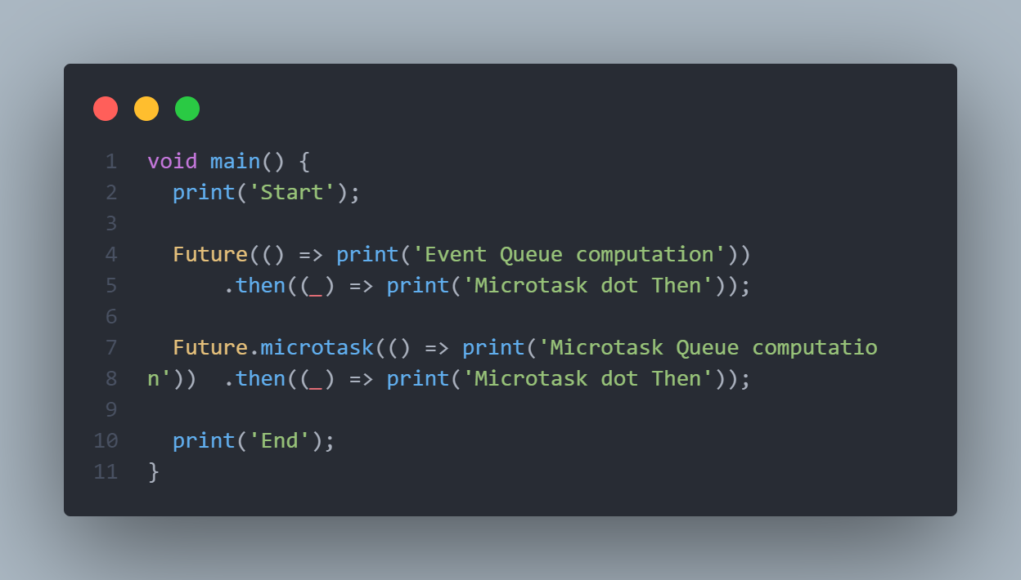
Quiz

Slide 25
3. Future.sync()
Synchronous Computation: Executes immediately.
Then Callbacks: Scheduled in the microtask queue.
Future.sync(() => print('Synchronous Computation')).then((_) => print('Microtask Then'));
Execution Order:
Executes print('Synchronous Computation') synchronously.
Schedules print('Microtask Then') in the microtask queue.

Slide 26
4. Future.value(value)
Completed Future: Immediately completes with value.
Then Callbacks: Scheduled in the microtask queue.
Future.value('Immediate Value').then((value) {print(value);});
Execution Order:
Schedules print('Immediate Value') in the microtask queue.

Slide 27
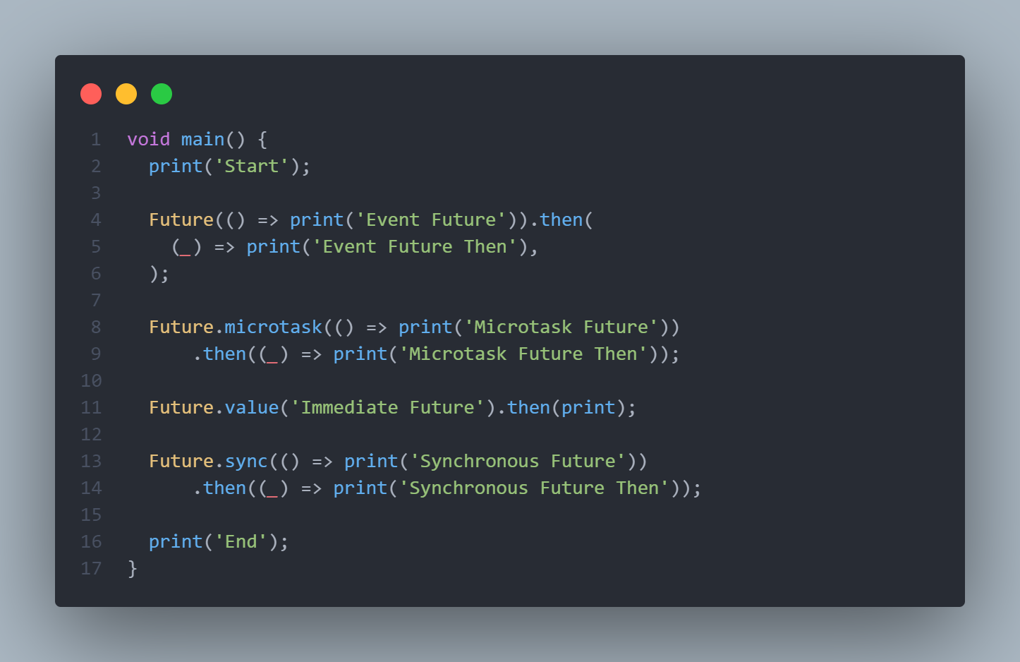
Comprehensive Example 1

Slide 28
Explanation:
Synchronous Code:
print('Start'); → Output: Start
Future.sync(() => print('Synchronous Future')); executes synchronously.
Output: Synchronous Future
print('End'); → Output: End
Microtask Queue:
Future.microtask(() => print('Microtask Future'));
Schedules print('Microtask Future') in the microtask queue. Its .then() callback schedules print('Microtask Future Then') in the microtask queue.
Future.value('Immediate Future').then(print); Schedules print('Immediate Future') in the microtask queue.
Future.sync(() => ...).then((_) => print('Synchronous Future Then’)); Schedules print('Synchronous Future Then') in the microtask queue.

Slide 29
Explanation:
Event Queue:
Future(() => print('Event Future’)); Schedules print('Event Future') in the event queue.
After execution, its .then() callback schedules print('Event Future Then'); in the microtask queue.

Slide 30
Execution Order:
Synchronous Code: Start, Synchronous Future, End
Microtasks:
Microtask Future → Output: Microtask Future
Microtask Future Then → Output: Microtask Future Then
Immediate Future → Output: Immediate Future
Synchronous Future Then → Output: Synchronous Future Then
Event Queue:
Event Future → Output: Event Future
Microtask:
Event Future Then → Output: Event Future Then

Slide 31
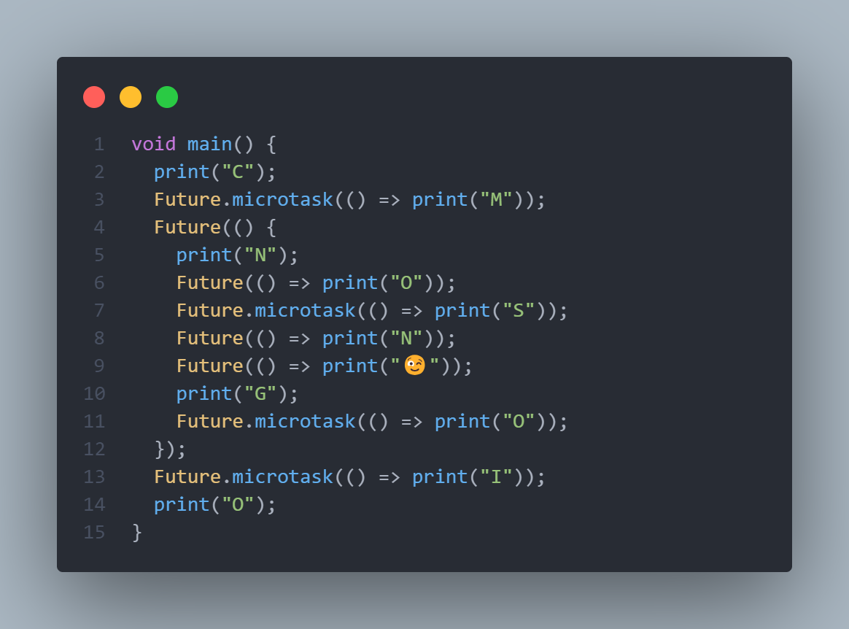
Quiz

Slide 32
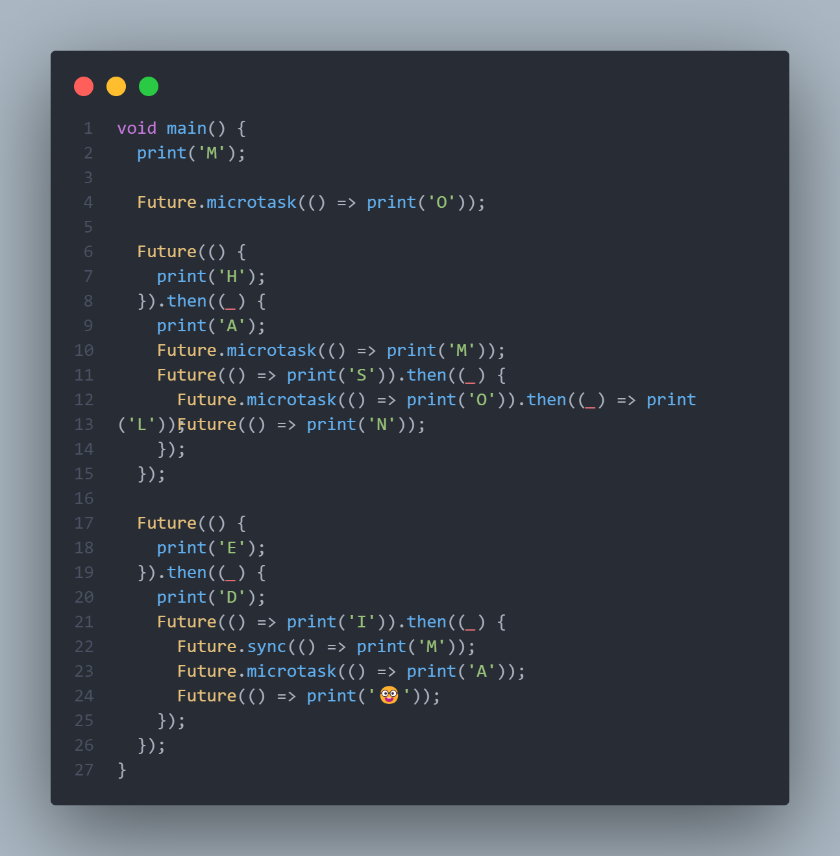
Quiz

Slide 33
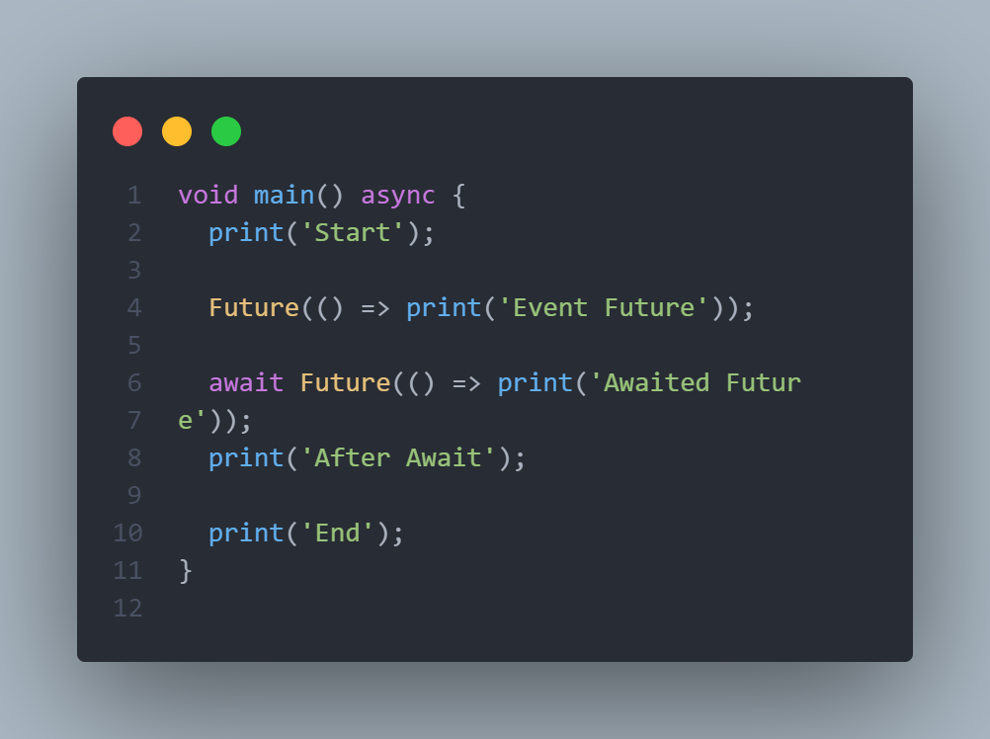
Async/Await:
When using async and await, the code after an await is scheduled in the microtask queue once the awaited Future completes.
Output:
// Start
// Event Future
// Awaited Future
// After Await
// End

Slide 34
Execution:
print('Start'); runs synchronously.
Future(() => print('Event Future')); schedules print('Event Future') in the event queue.
The await pauses the main function until Future(() => print('Awaited Future')) completes.
Schedules print('Awaited Future') in the event queue.
After Awaited Future prints, print('After Await'); is scheduled in the microtask queue.
Finally, print('End'); runs synchronously after the async function completes.
Note: The await effectively pauses the main function, but the rest of the event loop continues.

Slide 35
Key Takeaways:
Microtasks vs. Events: Microtasks are high-priority and run before events.
Future Scheduling:
Future(() => ...): Computation in event queue; .then() in microtask queue after computation.
Future.microtask(() => ...): Both computation and .then() in the microtask queue.
These tasks have higher priority in the microtask queue.
Future.value(...) and Future.sync(...): Complete immediately; .then() in microtask queue.

